Slide 1
Analyzing
NHANES
Survey Data
Udit Choudhary
Spring 2020 Data 606 : Capstone in Data Science

Slide 2
National Health and Nutrition Examination Survey
NHANES is a program of designed to assess the health and nutritional status of adults and children in the United States. The survey is unique in that it combines interviews and physical examinations. NHANES is a major program of the National Center for Health Statistics. NCHS is part of the Centers for Disease Control and Prevention (CDC) and has the responsibility for producing vital and health statistics for the United States.
The program was started in 1960s. In 1999, the survey became a continuous program that has a changing focus on a variety of health and nutrition measurements.

Slide 3

Cont..
Records statistics for over 5000 people every year.
Selected to represent the U.S. population of all ages. To produce reliable statistics, NHANES over-samples persons 60 and older, African Americans, and Hispanics.
Includes demographic, socioeconomic, dietary, and health-related questions. The examination consists of medical, dental, and physiological measurements, as well as laboratory tests administered by trained medical personnel.

Slide 4
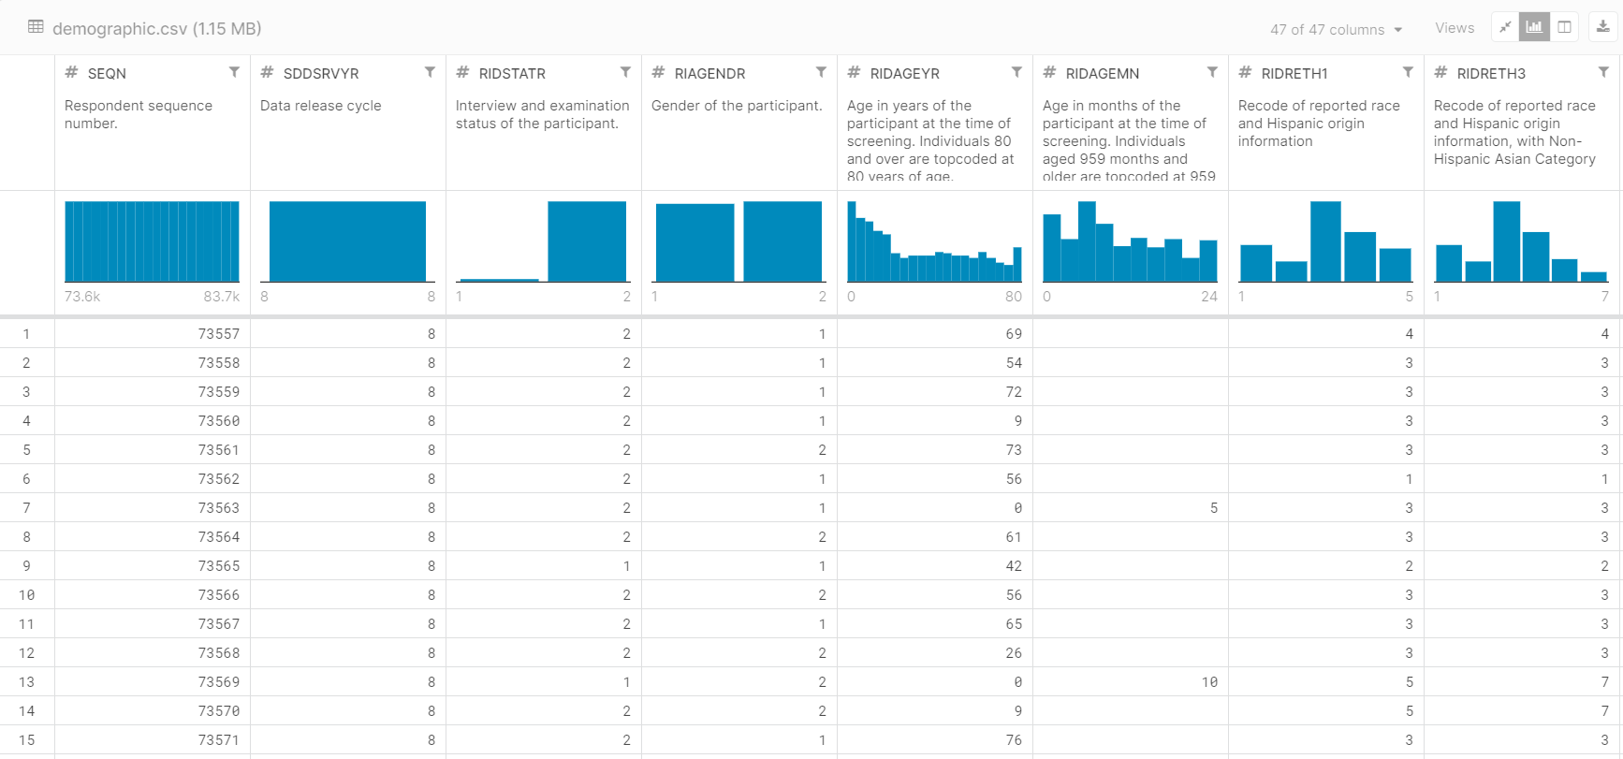
Preview of the Data

Slide 5
Accomplishments
Data used to create the growth charts used nationally by pediatricians to evaluate children’s growth.
Was instrumental in developing policy to eliminate lead from gasoline and in food and soft drink cans. This resulted in decline in elevated blood lead levels of more than 70% since the 1970s.
Has led to the proliferation of programs emphasizing diet and exercise, stimulated additional research, and provided a means to track trends in obesity.
Efforts by government and private agencies to increase public awareness, especially among minority populations, have been intensified based on NHANES data.
Helps the Food and Drug Administration decide if there is a need to change vitamin and mineral fortification regulations for the Nation’s food supply.
National programs to reduce hypertension and cholesterol levels continue to depend on NHANES data to steer education and prevention programs toward those at risk and to measure success in curtailing risk factors associated with heart diseases, the Nation’s number one cause of death.

Slide 6
Targets
Analyzing nutritional data and Physical examination data to predict presence or absence of diseases.
Predict Disease and Obesity trends.
Try to predict optimal nutritional requirements for various age groups

Slide 7
Tools and Techniques
Python
Pandas, sklearn, keras, tensorflow, matplotlib, numpy libraries
Machine Learning Techniques
K-means, Logistic Regression, SVM, Neural Networks, KNN Random Forests, and other classification and regression methods.

Slide 8
Thank You
Github : https://github.com/Udit2403/nhanes

